Slide 1

Database Mirroring Best Practices and Performance Considerations
Presented by Geyzerskiy Dmitriy
Senior Software Architect, db@net
Written by Mark Wistrom
Program Manager, Database Mirroring

Slide 2

Agenda
Introduction to Database Mirroring
How Database Mirroring Works
Transaction Safety
Performance Considerations
Network Considerations
Failover Considerations
Deployment Considerations
Monitoring
Questions

Slide 3
Database Mirroring in SP1
Fully supported now that SP1 has shipped
What is new for mirroring in SP1?
  Trace flag 1400 is not required
  Database Mirroring Monitor GUI

Slide 4
How Database Mirroring Works
No Mirroring
Application
Principal
Commit
3
1
SQL Server
2
>2
Log
Data

Slide 5
How Database Mirroring Works
Synchronous Mirroring
Application
Witness
Principal
Mirror
Commit
5
1
2.1
SQL Server
SQL Server
2
>2
4
3
>3
Log
Data
Log
Data

Slide 6
How Database Mirroring Works
Asynchronous Mirroring
Application
Principal
Mirror
Commit
3
1
>2
SQL Server
SQL Server
2
>2
>>>2
>>2
>>>2
Log
Data
Log
Data

Slide 7
Transaction Safety
Synchronous
  SAFETY FULL (Default)
    ALTER DATABASE <database name> SET SAFETY FULL
  Guaranteed protection of data
  High availability / High protection
  Allows automatic failover (with a witness)
Asynchronous
  SAFETY OFF
    ALTER DATABASE <database name> SET SAFETY OFF
  Potential loss of data in the event of failure
  High Performance mode
  Force service for failover
SAFETY FULL used interchangeably with Synchronous
SAFETY OFF used interchangeably with Asynchronous

Slide 8
Log in Principal and Mirror
Time
Principal
Amount of log not sent to mirror
Represents possible data loss
Send Queue
Unsent log
Amount of log sent to mirror
Log to redo on mirror
Represents failover time
  Redo Queue
  Unrecovered Log
Mirror

Slide 9

Database Mirroring In Action

Slide 10
Agenda
Introduction to Database Mirroring
How Database Mirroring Works
Transaction Safety
Performance Considerations
Network Considerations
Failover Considerations
Deployment Considerations
Monitoring
Questions

Slide 11
Database Mirroring Performance
What Influences Performance ?
Database Mirroring in SQL Server 2005
http://www.microsoft.com/technet/prodtechnol/sql/2005/dbmirror.mspx
Database Mirroring Best Practices http://www.microsoft.com/technet/prodtechnol/sql/2005/technologies/dbm_best_pract.mspx

Slide 12
What Influences Performance?
Synchronous Mirroring
The most important factor is the log generation rate
Application
Witness
Principal
Commit
5
Mirror
1
2.1
SQL Server
SQL Server
2
>2
4
3
>3
Log
Data
Log
Data

Slide 13
What Influences Performance ?
Log generation rate
Network latency and bandwidth
Transaction safety level
Number of concurrent user connections
Transaction size and volume
___________________________________
Your mileage may vary

Slide 14
Test Workloads
Characteristic | Workload1 | Workload2
Database size (GB) | 40 | 20
Number of concurrent user connections | 1000 | 20
Maximum think time between transactions (sec) | 4 | 0
Baseline (No Mirroring) %CPU | 4 | 40
Baseline (No Mirroring) Transactions / sec | 241 | 215
Baseline (No Mirroring) log generation rate (KB / sec) | 720 | 12000

Slide 15
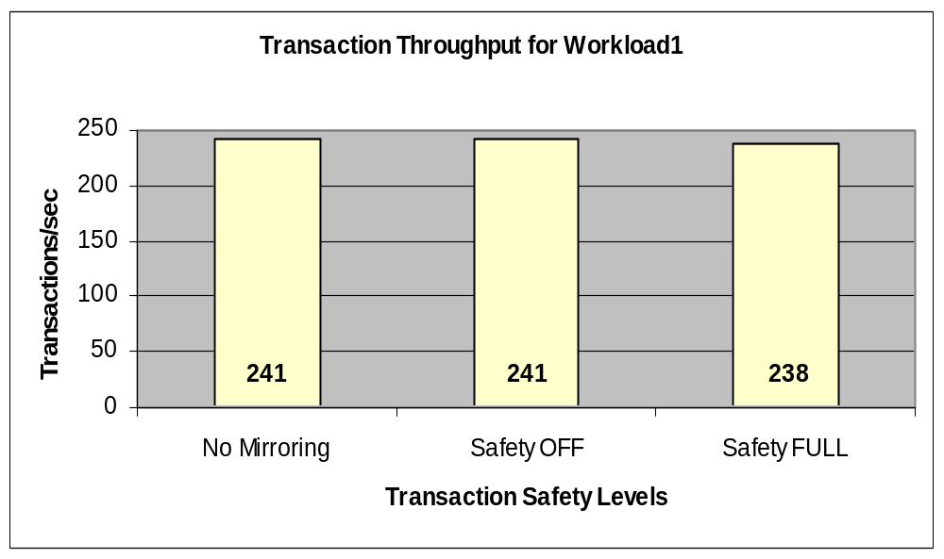
Transaction Safety vs. Performance
Workload1
Marginal impact when log generation rate is low

Slide 16
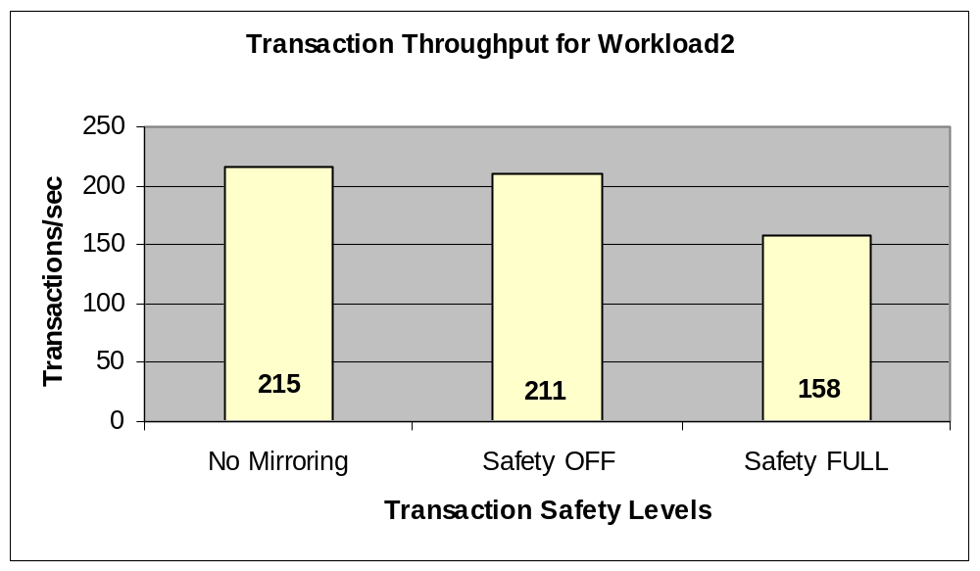
Transaction Safety vs. Performance
Workload2
More impact when log generation rate is high

Slide 17
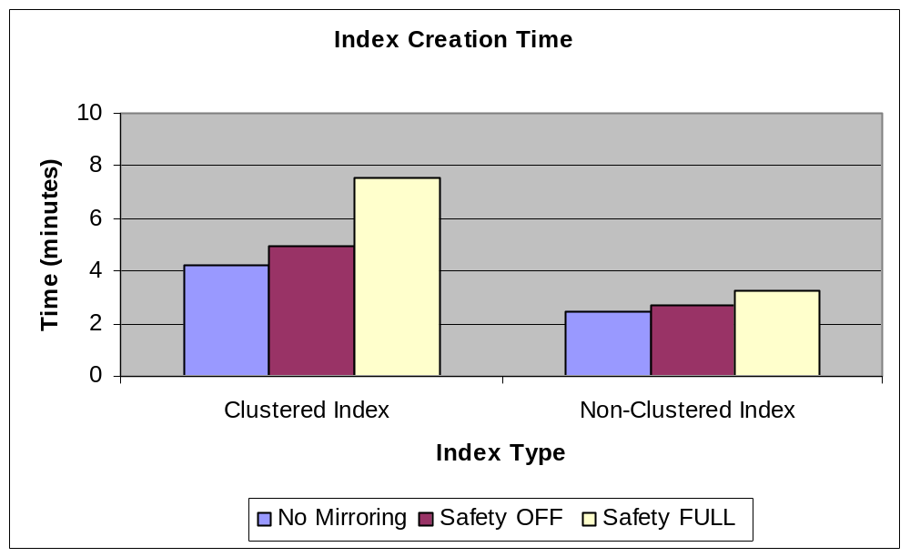
Transaction Safety vs. Performance
Index Creation
More log generated for clustered index → higher impact on performance

Slide 18
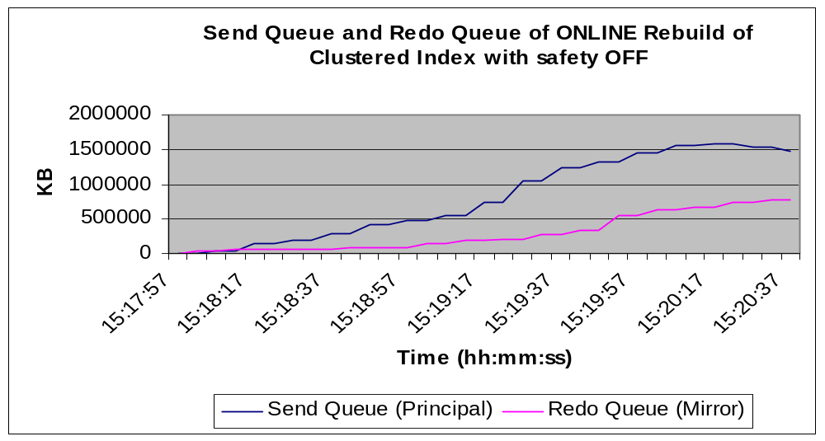
Impact of Asynchronous Mirroring on Send Queue and Redo Queue
ONLINE Clustered Index Rebuild

Slide 19
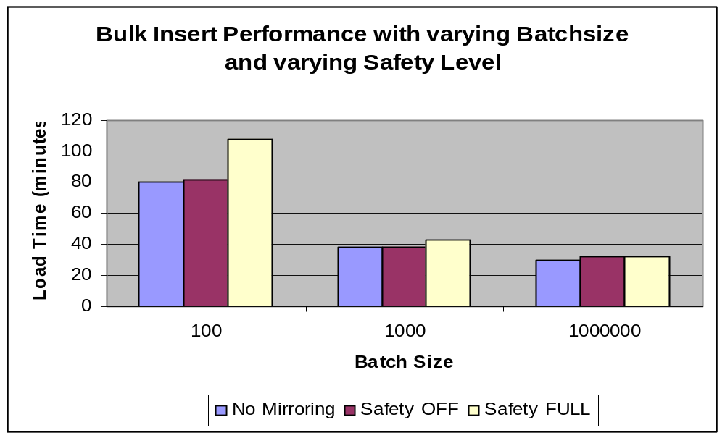
Transaction Safety vs. Performance
Impact of Transaction Size
BULK INSERT of 93 Million rows
Shorter transactions → Relatively larger impact on performance

Slide 20
Agenda
Introduction to Database Mirroring
How Database Mirroring Works
Transaction Safety
Performance Considerations
Network Considerations
Failover Considerations
Deployment Considerations
Monitoring
Questions

Slide 21
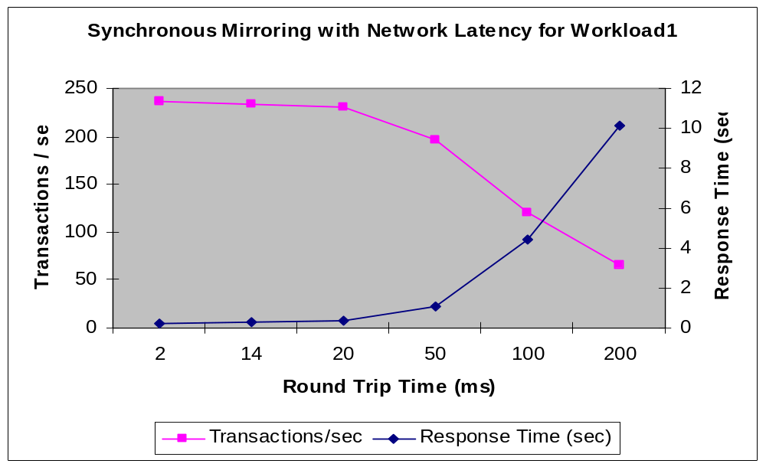
Impact of Network Latency
Synchronous with Workload1

Slide 22
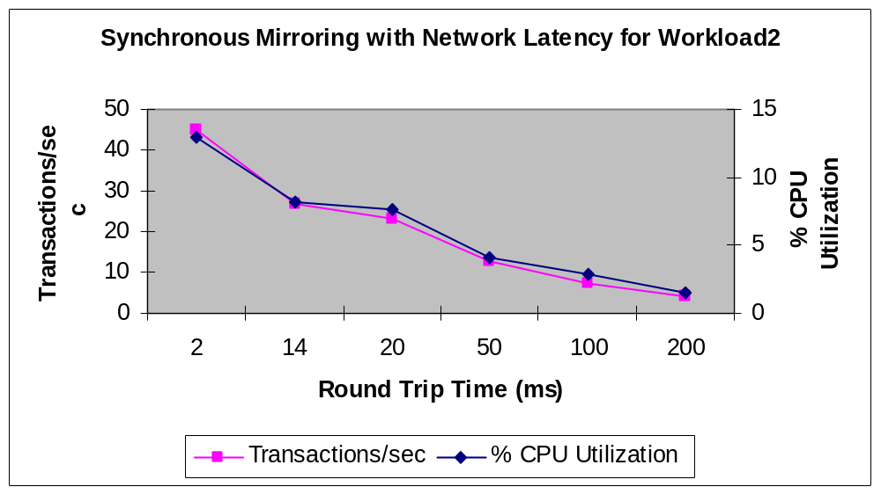
Impact of Network Latency
Synchronous with Workload2

Slide 23
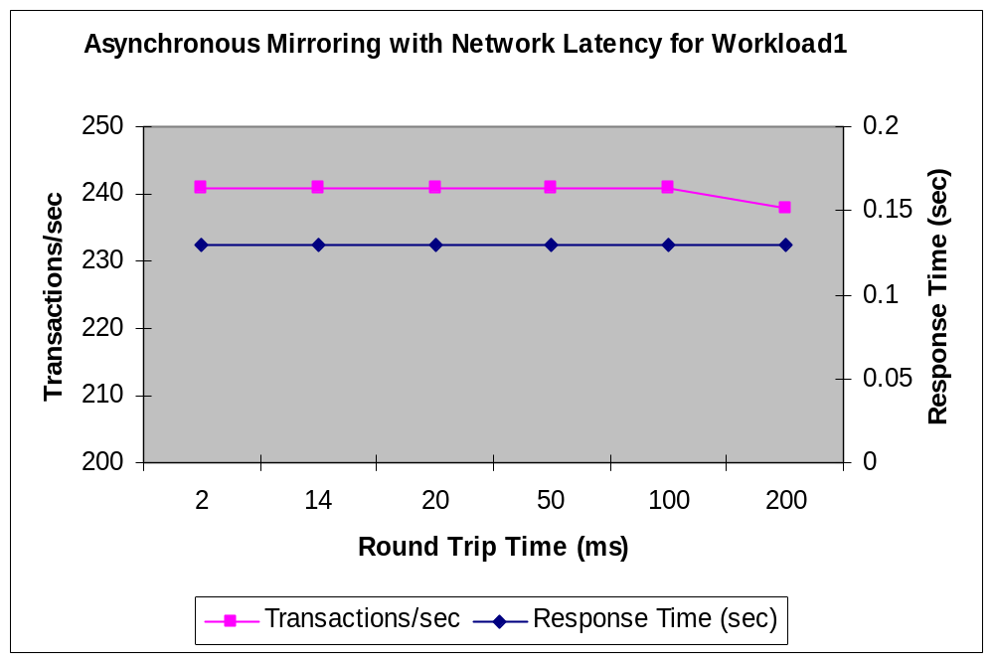
Impact of Network Latency
Asynchronous with Workload1

Slide 24
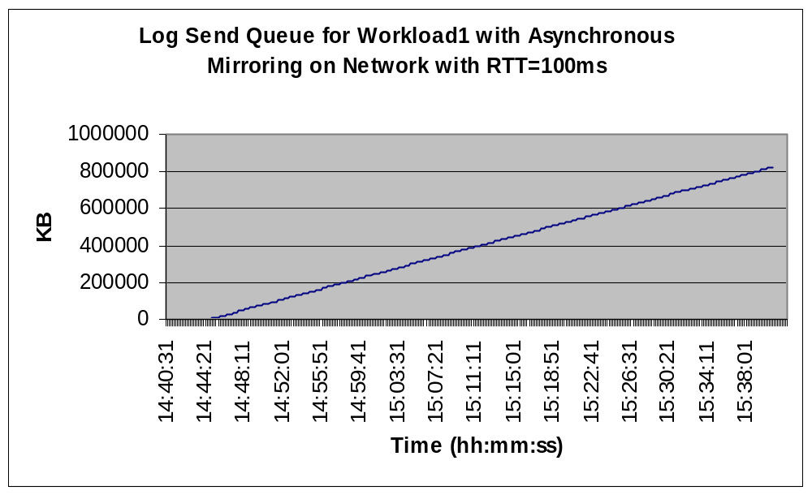
Impact of Network Latency
Send Queue: Asynchronous with Workload1

Slide 25
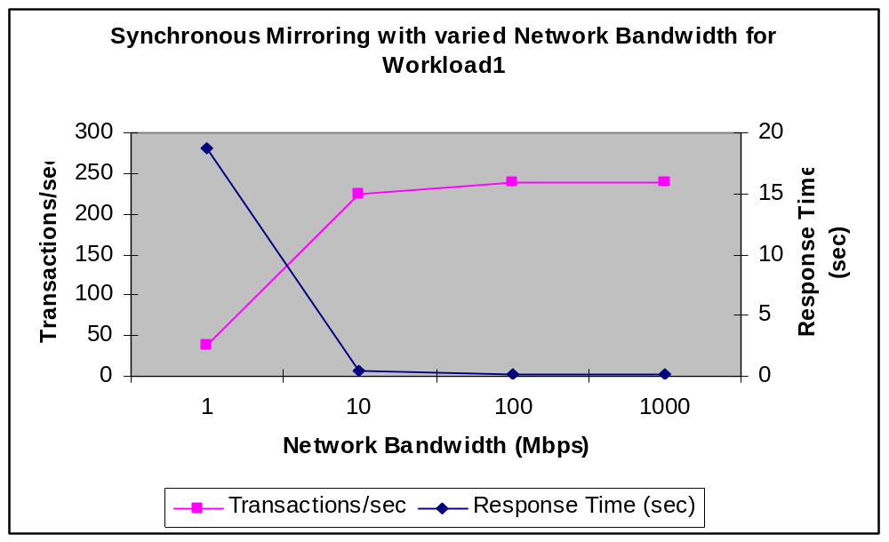
Impact of Network Bandwidth
Synchronous with Workload1

Slide 26
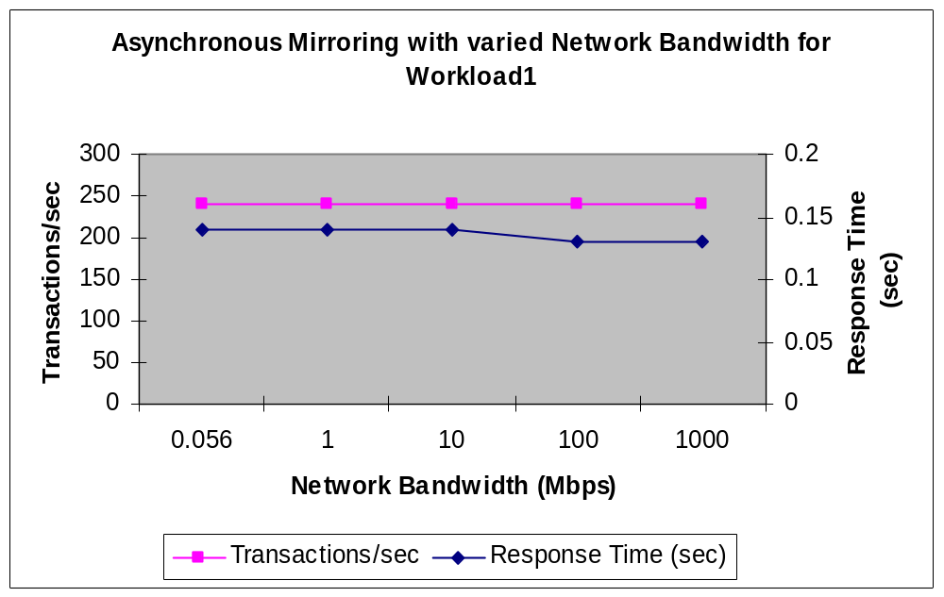
Impact of Network Bandwidth
Asynchronous with Workload1

Slide 27
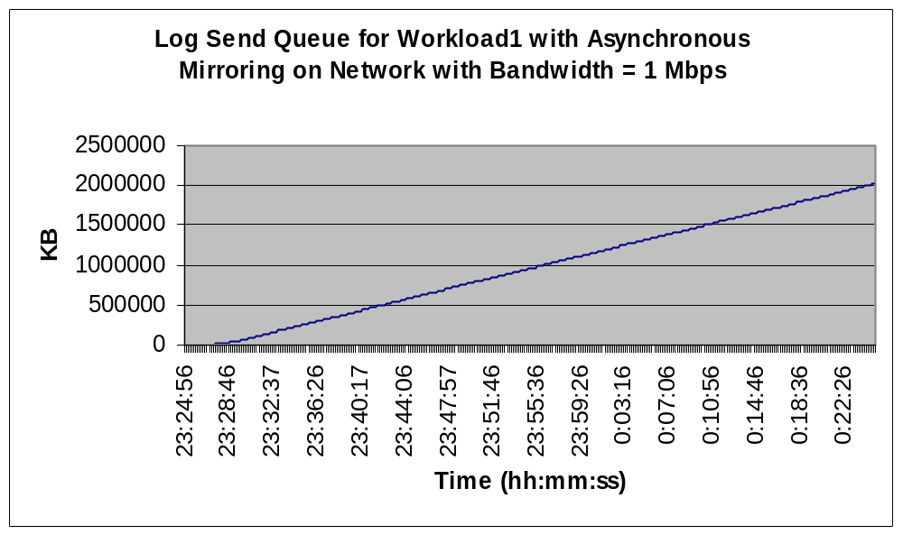
Impact of Network Bandwidth
Send Queue: Asynchronous with Workload1

Slide 28
Agenda
Introduction to Database Mirroring
How Database Mirroring Works
Transaction Safety
Performance Considerations
Network Considerations
Failover Considerations
Deployment Considerations
Monitoring
Questions

Slide 29
Operation Modes
Operation Mode | Witness | Safety Level | Automatic Failover | Possible Data Loss on Failover
Synchronous with Witness | Yes | FULL | Yes | No
Synchronous without Witness | No | FULL | No | No
Asynchronous | No | OFF | No | Yes

Slide 30
Failover Considerations
Failover is at a database level
  No group / instance failover
Data outside the database is not propagated
  Master: logins, user written stored procedure, etc.
  MSDB: Jobs, histories, etc.

Slide 31
Events During an Automatic Failover
Failure occurs
Time to coordinate with witness.
Database available
Time to detect failure.
Fixed overhead
Time
Failure detected
Redo Complete
Decide to failover
Redo Phase
Undo Phase
The time from detecting the failure of the principal to the time the mirror assumes the role of the principal is the database failover time

Slide 32
Failure Detection for Automatic Failover
Two different types of failures
  SQL Server
    Ping each other once a second
    By default if 10 “pings” are missed, then declare a failure
  Outside SQL Server
    Operating system
    Network errors
    IO errors
    Process errors

Slide 33
Examples of Failures
Fast
SQL Server instance crashes
  Endpoint closes port quickly
  Network retry from partner quickly fails
    OS says that the port is closed
  Fast failure!
  Failover begins in seconds

Slide 34
Examples of Failures
Not as fast
Catastrophic server failure
  Power supply fails
  Network retry from partner waits for timeout
  SQL Server “ping” will most likely fail first
  Failover begins in 10 seconds

Slide 35
Examples of Failures
Slower…
Someone pulls the log drive on principal
  Pending IOs to the log drive queue up
  SQL Server “pings” are working fine
  After 20 seconds, SQL Server issues IO warning
  After 40 seconds, SQL Server declares IO failure
  Failover begins 40 seconds after log drive is pulled

Slide 36
Examples of Failures
Either No failover or Fast failover
Database page fails checksum
  Client connection is broken
  Transaction rolls back automatically
  No failover
Database page fails checksum
  Transaction was in the middle of a rollback
  Now the database is inconsistent
  Database goes SUSPECT
  Fast failover!!!

Slide 37
Issues with Extended Disconnects
Long Disconnects
  Mirror unavailable → DISCONNECTED
  Mirroring session suspended → SUSPENDED
Log records keep accumulating at the principal
Transaction log can NOT be truncated, even if you backup
transaction log
May eventually fill up the transaction log space and the database comes to halt
Look at LOG_REUSE_WAIT_DESC column in sys.databases
RESUME the mirroring session, or break it (manually resynchronize via backup/copy/restore, resume mirroring – just as when you setup mirroring)

Slide 38
Agenda
Introduction to Database Mirroring
How Database Mirroring Works
Transaction Safety
Performance Considerations
Network Considerations
Failover Considerations
Deployment Considerations
Monitoring
Questions

Slide 39
Deployment Considerations 1
Operation Mode | Witness | Safety Level | Automatic Failover | Possible Data Loss on Failover
Synchronous with Witness | Yes | FULL | Yes | No
Synchronous without Witness | No | FULL | No | No
Asynchronous | No | OFF | No | Yes

Slide 40
Deployment Considerations 2
Customer stories
  Mission critical applications deploying synchronous with witness
  For DR, customers deploy asynchronous with great success
  Some customers want synchronous, but prefer manual failover
    Multiple databases
    Corporate IT policies demand human involvement
Start simple with asynchronous mirroring
Increase complexity as needed – one at a time
  Turn on synchronous
  Add a witness

Slide 41
Deployment Considerations 3
Manage Planned downtime
  Rolling upgrade
    Upgrade the mirror first
    Failover
    Upgrade the new mirror
    Failover again
  If using asynchronous mirroring
    Wait for a low activity window
    Switch to synchronous, and wait till SYNCHRONIZED
    Use rolling upgrade as above
    Switch back to asynchronous
Can deploy database mirroring with log shipping
  For multiple destinations
If replacing log shipping
  Consider impact on recovery model

Slide 42
Keeping the Mirror Prepared
Recommended identical partner servers
Same edition of SQL Server on both partners
Same service pack for the SQL Server on both partners
  Except during a rolling upgrade (up-level support?)
Identical directory structure
Same SQL Server configuration (trace flags, startup options, memory settings, etc.) on both partners
Identical SQL Server logins / permissions on both partners
Copy over the SQL Agent jobs, alerts, SSIS packages, maintenance plans, etc. from one partner to the other
Add a disk volume on one partner → Do the same on the mirror
Test failover, and make sure the application works identically on both partners

Slide 43
Agenda
Introduction to Database Mirroring
How Database Mirroring Works
Transaction Safety
Performance Considerations
Network Considerations
Failover Considerations
Deployment Considerations
Monitoring
Questions

Slide 44
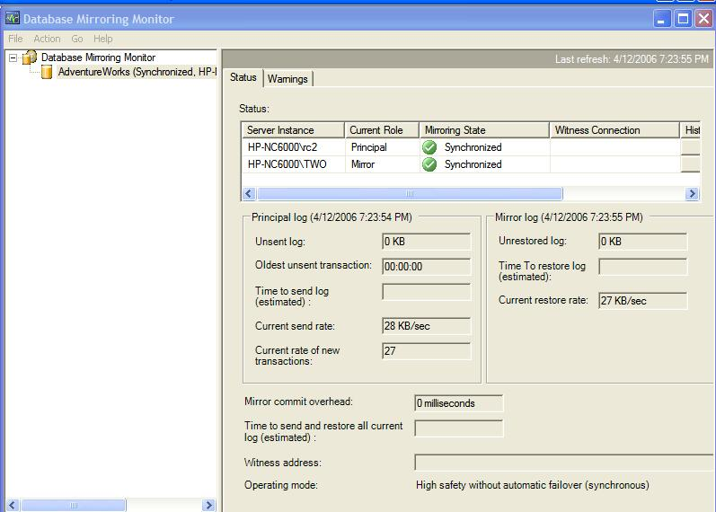
Database Mirroring Monitor
Send Queue
Redo Queue
Redo Rate

Slide 45
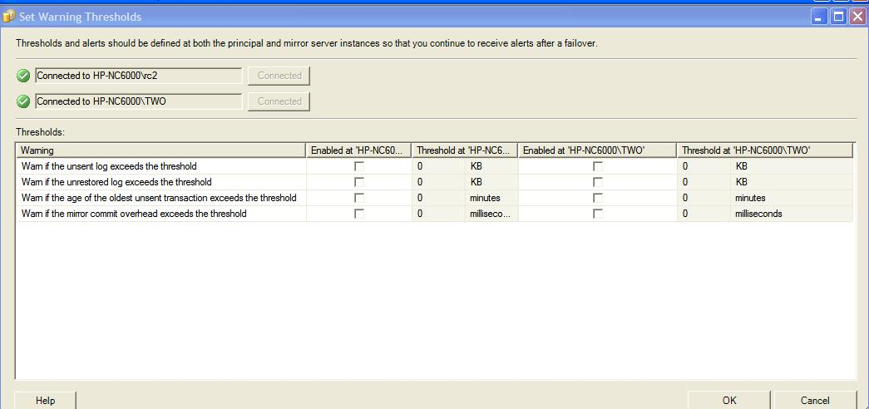
Database Mirroring Monitor
Menu: Action -> Set Warning Thresholds…

Slide 46
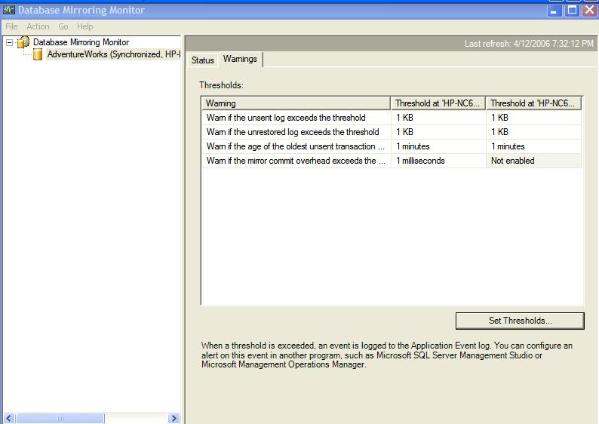
Database Mirroring Monitor

Slide 47
Summary
How Database Mirroring Works
Performance Impact of Transaction Safety
Impact of Network Latency and Bandwidth
Failure Scenarios and Failover Considerations
Deployment Scenarios
Database Mirroring Monitor

Slide 48
Summary
Performance Considerations
Applications generating more transaction log experience higher performance impact with database mirroring
Applications with fewer connections experience more impact on transaction throughput when synchronous mirroring is turned on
Applications with smaller transaction size experience relatively larger performance impact with database mirroring
Applications with low transaction log rate may sustain acceptable throughput with slight reduction in network bandwidth or slight increase in the network latency
Applications with high transaction log rate may experience severe performance degradation with lower network bandwidth or higher network latency
While using asynchronous mirroring, monitor send queue to determine the possible data loss in the event of failure of the principal

Slide 49
Summary
Best Practices Recommendations
Start simple (asynchronous) and then gradually increase complexity to synchronous without witness (therefore without automatic detection/automatic failover) and then add the witness
If you are not interested in automatic failover, don’t setup a witness
Understand performance and availability requirements of the application
Synchronous database mirroring is “generally” not recommended for a remote mirror
Keep the mirror prepared for a failover, but transferring the logins, jobs, etc.
Test performance implications thoroughly before setting up in production
Test performance over network before deploying mirroring between two geographically distant servers
Test failover with different failure scenarios

Slide 50
For More Information
Technical Whitepapers http://www.microsoft.com/technet/prodtechnol/sql/2005/technologies/dbm_best_pract.mspx http://www.microsoft.com/technet/prodtechnol/sql/2005/dbmirror.mspx http://www.microsoft.com/technet/prodtechnol/sql/2005/dbmirfaq.mspx Customer Case Studies http://download.microsoft.com/documents/customerevidence/26366_serviceu_cs_final.doc http://download.microsoft.com/documents/customerevidence/26365_ORF_SQLServer2005_casestudy.doc http://download.microsoft.com/documents/customerevidence/26373_Mediterranean_Shipping_case_study.doc Database Mirroring Books Online http://msdn2.microsoft.com/en-us/ms177412(SQL.90).aspx MSDN Forum on Database Mirroring http://forums.microsoft.com/MSDN/ShowForum.aspx?ForumID=227&SiteID=1

Slide 51


Slide 52
APPENDIX

Slide 53
Introduction to Database Mirroring
New High Availability feature in SQL Server 2005 SP1
Maintains a duplicate copy of the database
That’s kept up-to-date
  Synchronously, or
  Asynchronously
To which you can failover
  Automatically, or
  Manually
Which can reside
  Locally, or
  Remotely

Slide 54
Introduction to Database Mirroring 2
Two copies of the same database on two servers
Role playing:
  Principal
    This copy is accessible
    Currently serving the database
    Available for connections
  Mirror
    Always in the “Restoring” state
    Not available for connections
Role switching at failover

Slide 55
Introduction to Database Mirroring 3
Witness
  Optional, third SQL Server instance
  Used for quorum in the event of failover
  Used only for automatic failover
  Answers the question “who do you see”?
  Not a decision maker
  Not a single point of failure
  Not involved in any data processing

Slide 56
Introduction to Database Mirroring 4
Granularity / Scope → Database
Multiple databases in an instance can be mirrored
Only one mirror database for each principal database
Requires FULL recovery model
Cannot mirror the master, msdb, temp, or model databases

Slide 57
Endpoint Encryption
Endpoints are encrypted by default
Three possible settings:
  REQUIRED (default)
  SUPPORTED
  DISABLED
Two encryption algorithms supported
  RC4
  AES
Very minimal impact on performance

Slide 58
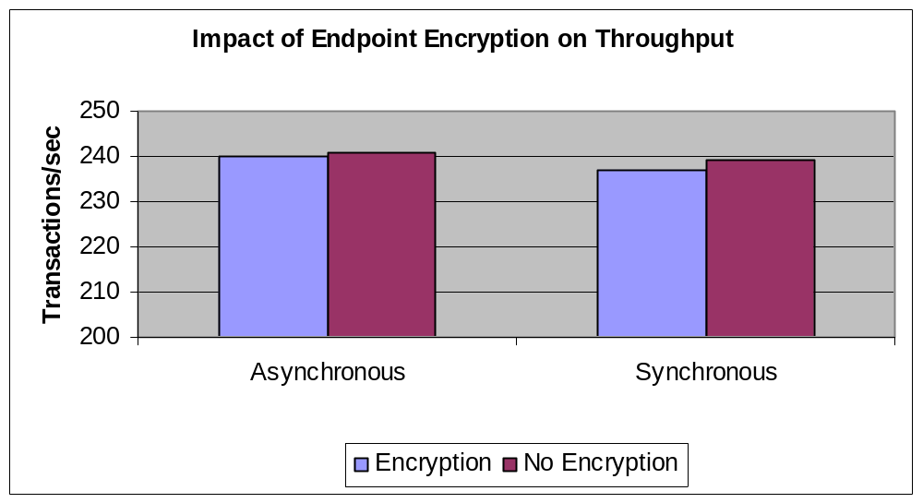
Transaction Throughput with
Endpoint Encryption
Marginal impact on throughput

Slide 59
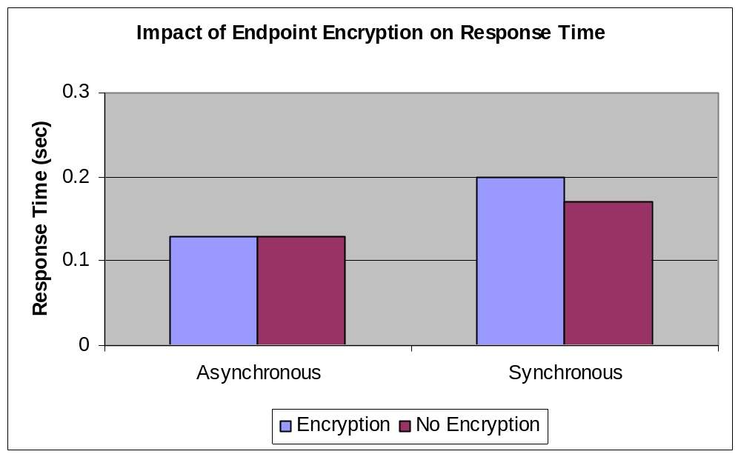
Transaction Response Time with
Endpoint Encryption
Marginal impact on response time

Slide 60
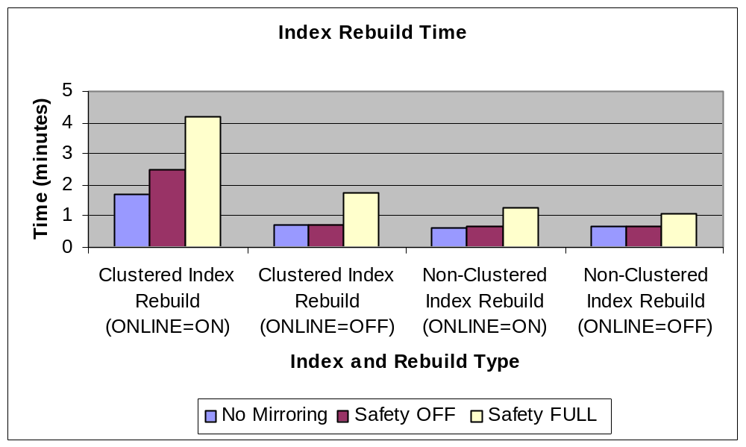
Transaction Safety vs. Performance
Index Rebuild

Slide 61
Failover Scenarios
Loss of Principal
Synchronous with Witness
No loss of data
Automatic failover
Mirror takes up the role of principal
Principal is exposed (unprotected)
When the failed database becomes operational
  Automatically assumes the role of the mirror
  Starts syncing up
Synchronous without Witness
No loss of data
Manual intervention
Break the mirroring session and then recover the mirror database
    ALTER DATABASE <database name> SET PARTNER OFF
    RESTORE DATABASE <database name> WITH RECOVERY
When the failed database becomes operational
  Need to re-establish the mirroring session

Slide 62

Failover Scenarios
Loss of Principal
Asynchronous
Possible data loss
Witness doesn’t help
Manual intervention – Two options
  Force Service
    ALTER DATABASE < database name > SET PARTNER FORCE_SERVICE_ALLOW_DATA_LOSS
    When the failed database becomes operational
      Automatically assume the role of the mirror
      Mirroring session remains SUSPENDED
  Break mirroring session and recover the mirror
    ALTER DATABASE <database name> SET PARTNER OFF
    RESTORE DATABASE <database name> WITH RECOVERY
    When the failed database becomes operational
      Need to re-establish the mirroring session

Slide 63
Failover Scenarios
Loss of Mirror
Doesn’t matter whether Synchronous or Asynchronous
Witness doesn’t matter directly, but matters indirectly
(discussed later)
Principal continues to run (but unprotected)
When the mirror database becomes operational
  Automatically assumes the role of the mirror
  Starts syncing up with the principal

Slide 64
Failover Scenarios
Loss of Witness
Principal and mirror continue functioning without interruption
Automatic failover is disabled
Once the witness becomes operational
  Automatically joins in as witness

Slide 65
Failover Scenarios
Loss of Mirror and Witness
Loss of Mirror → Principal is unprotected
Also loose the Witness → Principal becomes “isolated”
Can’t serve the applications
If the mirror or the witness can’t be brought back online quickly, the only way out is to break the mirroring session
  ALTER DATABASE <database name> SET PARTNER OFF
Re-establish database mirroring session when the mirror
becomes available
  If you have backed up the transaction log during the time when the mirroring session was broken, restore the log on the mirror; else
  Just set partners, and the mirror will start to resync automatically

Slide 66
Measuring Failover Time
Using SQL Server Profiler
Select
  event “Database Mirroring State Change”
  columns “StartTime” and “TextData”
Start Profiler trace, and observe messages during failover
Sample messages in SQL Server Profiler during failover
StartTime | TextData
2005-10-22 12:39:17.960 | DBM: Synchronized Mirror with Witness -> DBM: Connection with Principal Lost
2005-10-22 12:39:18.570 | DBM: Connection with Principal Lost -> DBM: Automatic Failover
2005-10-22 12:39:20.590 | DBM: Automatic Failover -> DBM: Principal Running Exposed

Slide 67
Monitoring Database Mirroring
Perfmon Counters
On the Principal
Log Bytes Sent/sec
Log Send Queue KB
Transaction Delay
Transactions/sec
Log Bytes Flushed/sec
Disk Write Bytes/sec
On the Mirror
Redo Bytes/sec
Redo Queue KB
Disk Write Bytes/sec

Slide 68
Monitoring Database Mirroring
Catalog Views and DMVs
sys.database_mirroring
sys.database_mirroring_endpoints
sys.database_mirroring_witnesses
sys.tcp_endpoints
sys.dm_db_mirroring_connections

Slide 69
Database Mirroring and
SQL Server 2005 Editions
Database Mirroring Feature | Enterprise Edition | Standard Edition | Workgroup Edition | SQL Express
Partner | √ | √
Witness | √ | √ | √ | √
Synchronous | √ | √
Asynchronous | √
Available during UNDO after failover | √ | √
Parallel redo | √
Database Snapshots | √

Slide 70
Comparison: Database Mirroring,
Failover Clustering and Log Shipping
Feature | Database Mirroring | Failover Clustering | Log Shipping
Data Loss | No data loss option | No data loss | Maybe
Failover | Automatic failover option | Automatic failover | No
Failover time | seconds | ~ 20+ seconds | Manual
Special Hardware | No | Certified hardware | No
Redundancy | Complete redundancy | Disks are shared | Complete redundancy
Multiple Secondaries | No | No | Yes
Standby Read Access | Yes, through snapshot | No | Yes, WITH STANDBY option
Granularity | Database | Instance | Database

